Slide 1

New Movie Studio Analysis for film production
Type of films for Strategic Investment
John Widno DORCY
July 27, 2025

Slide 2
Business Understanding
Objective:
The Project aims to help the company to create original video content and to get in on fun.
Goal:
Identify what types of films are currently doing the best at the box office..
Business Impact:
Informed decision-making to produce the best type of movies that people are interested and have good profit.

Slide 3

Data Understanding
Data Sources:
Our analysis combines IMDb's comprehensive movie
metadata (ratings, genres, runtime) with TN Movie Budjet‘
verified and revenue data to identify high-performing
film trends." "Data sources: IMDb (SQLite) for movie attributes +
tn Movie Budjet(CSV).
Key Features:
Avarage Rating, Number of votes
Ordering, Tittle, region , Genres
Incident and accident reports
Operator information
Production Budjet
Domestic Gross, Worldwide Gross
Start year

Slide 4
Data Challenges
Missing values
Inconsistent formats
Feature engineering, cleaning and Transforming.
Need for merging multiple datasets

Slide 5
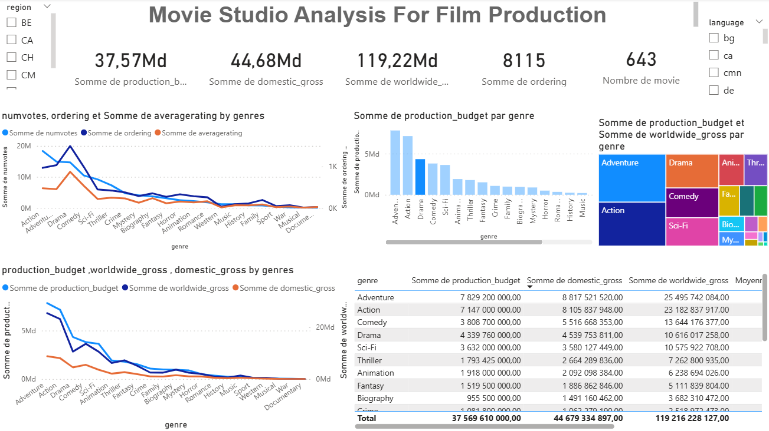
Data Challenges
Steps Taken:
Removed duplicates
Handled missing values
Standardized the data.
Imputation Techniques:
imputation for numerical features
flagging for categorical fields
Unknow string feacture
Outcome:
Clean, unified dataset ready for analysis

Slide 6
Data Analysis
Risk Scoring Methodology:
Calculated incident rate per 1,000 flight hours
Adjusted for aircraft age and usage intensity
Insights:
Certain manufacturers had consistently lower incident rates
Newer aircraft models showed improved safety records
Visualization Preview:
Bar chart: Incident rate by aircraft model
Heatmap: Correlation between age and incident frequency

Slide 7

Data Analysis

Slide 8
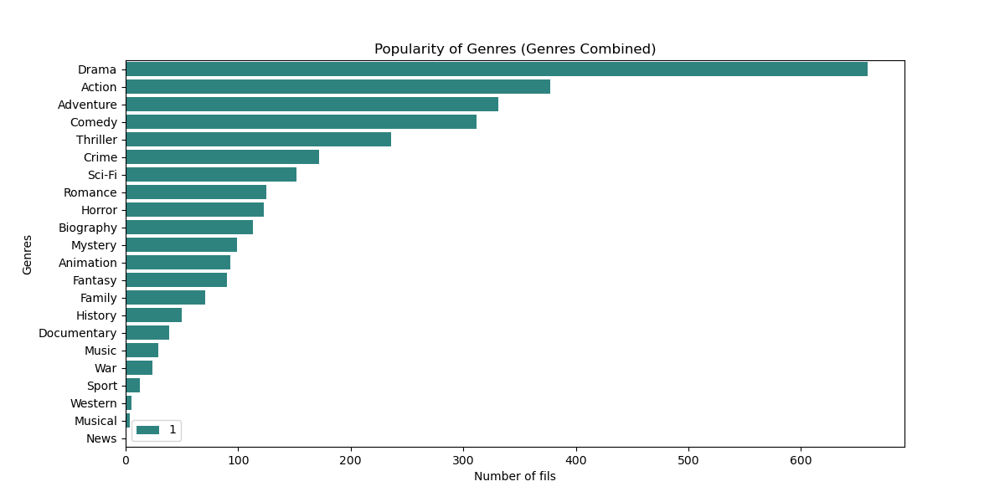
Data Analysis

Slide 9
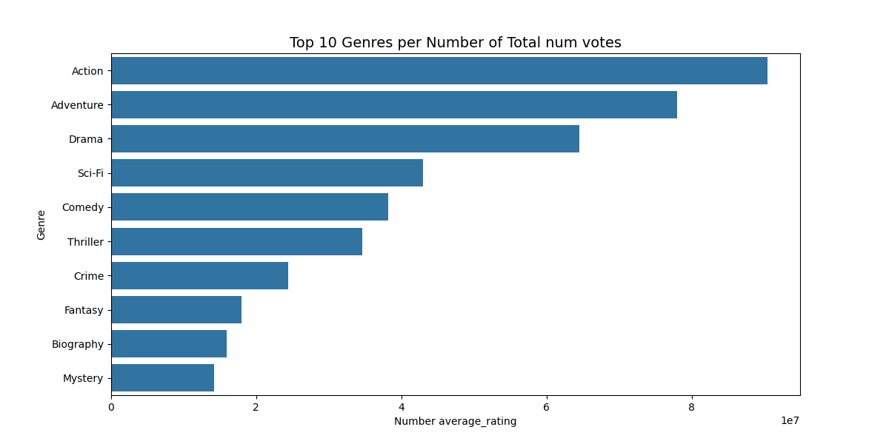
Data Analysis

Slide 10
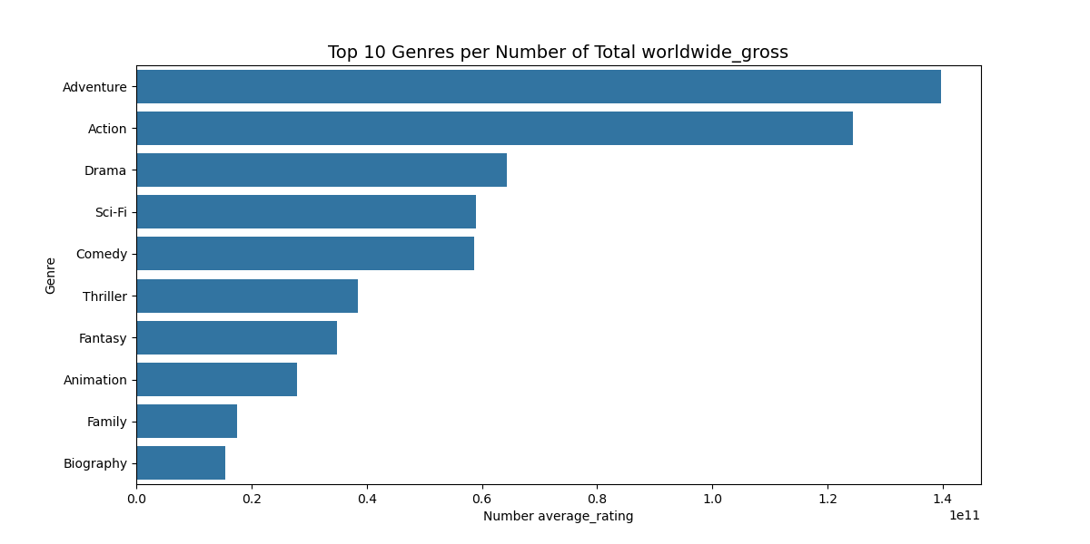
Data Analysis

Slide 11
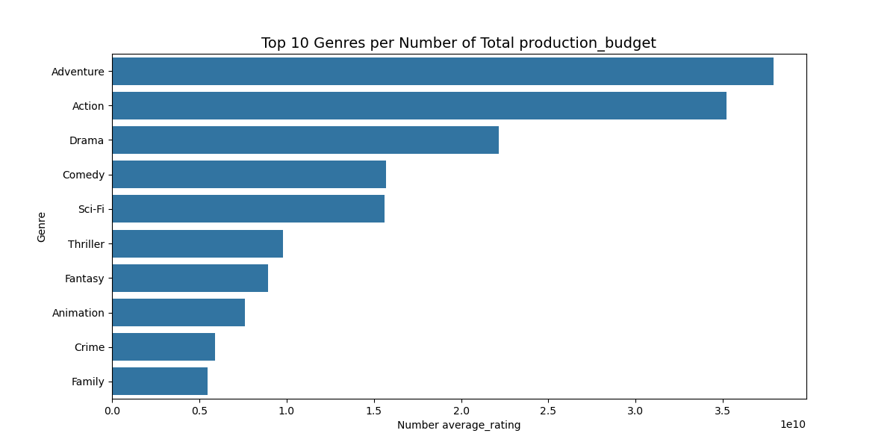
Data Analysis

Slide 12
Recommendations
Movie Models to the Company
The most common genres are:
Drama
Comedy
Action
Thriller
Adventure
Romance
Documentory
However, the most successful genres (combining ratings and votes) are:
Action
Adventure
Drama
comedy.

Slide 13
Business Movie Summary
The most successful genres (production_budget and worldwide_gross
Grouping by Genres
Drama
Action
Adventure
Drama,
comedy
Thriller
Action
Adventure
Comedy
Based on the Production Budget and Aorldwide Gross , we recommend producing Movie such as the movies below.

Slide 14
Next Steps
We recommend starting Action, Drama, Adventure and comedy . This allows the company to enter the market with minimal operational risk.
Find the report online on power bi services
Presentation -Phase_2 - Power BI

Slide 15
Thank You
Contact Info:
John Widno Dorcy
+50938058388
LinkedIn: linkedin.com/in/john-widno-dorcy-19399a216
GitHub: github.com/johnwidno

